Slide 1
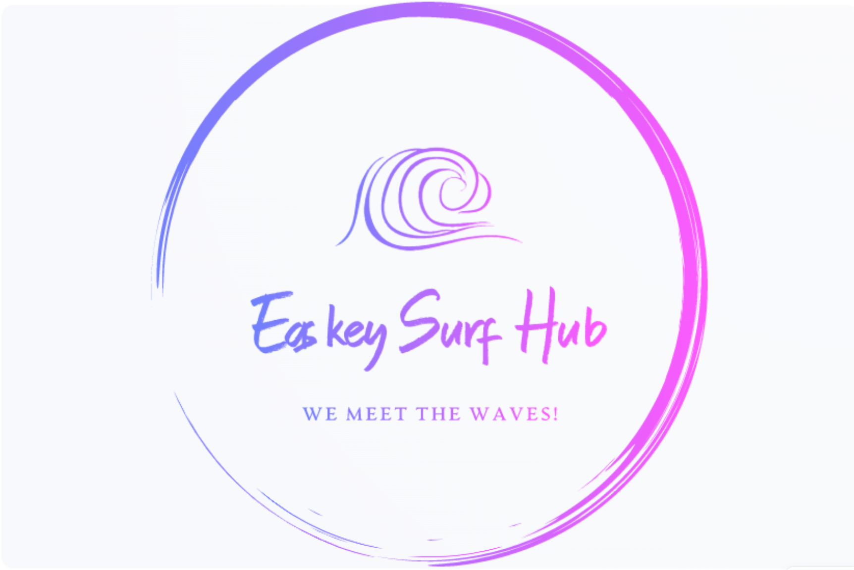

Slide 2
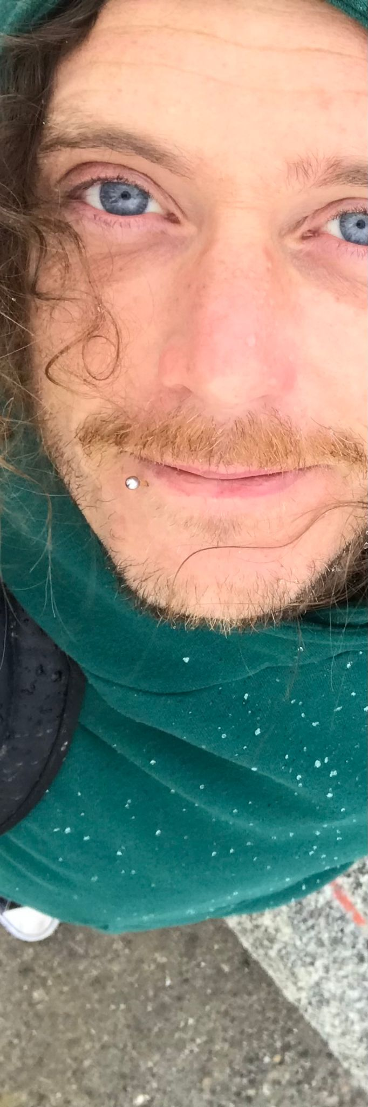
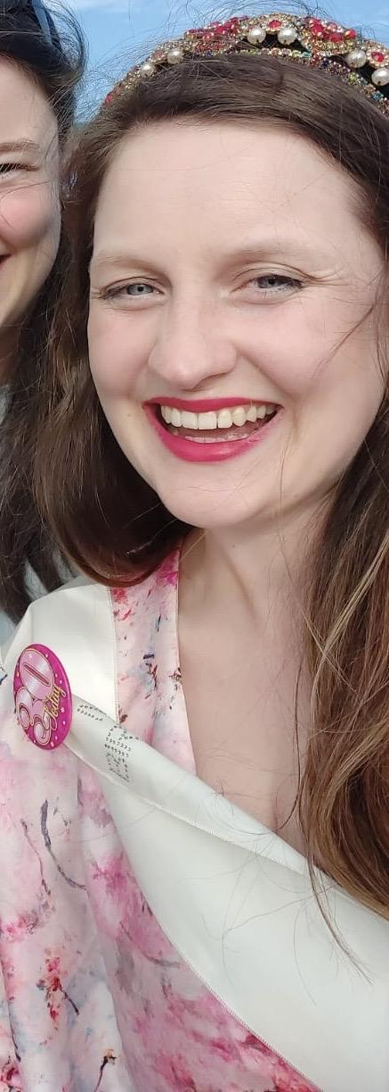
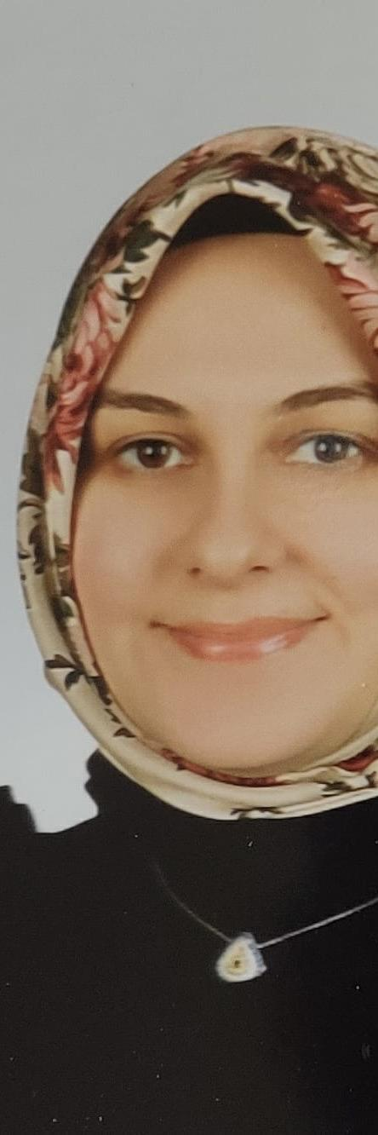

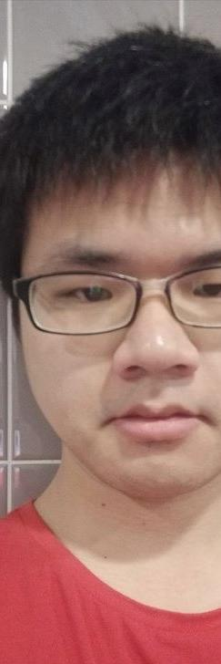
The Fantastic 5++
Nat Cafolla
Una
Fleming
Neslihan Onur
Gayathri Sangavi
Yuzhou Shao

Slide 3

Project Brief
> Requirements of the site:
> Two Users: Customers (Unregistered and Registered) & Staff
> Provide information about the surf school, including info on lesson times/ accommodation.
> Allow registered customers to: view, select, pay & manage bookings.
> Allow staff to: edit information (inc. bills).
Úna Fleming
Notes:
Úna discussing the project specification document.

Slide 4

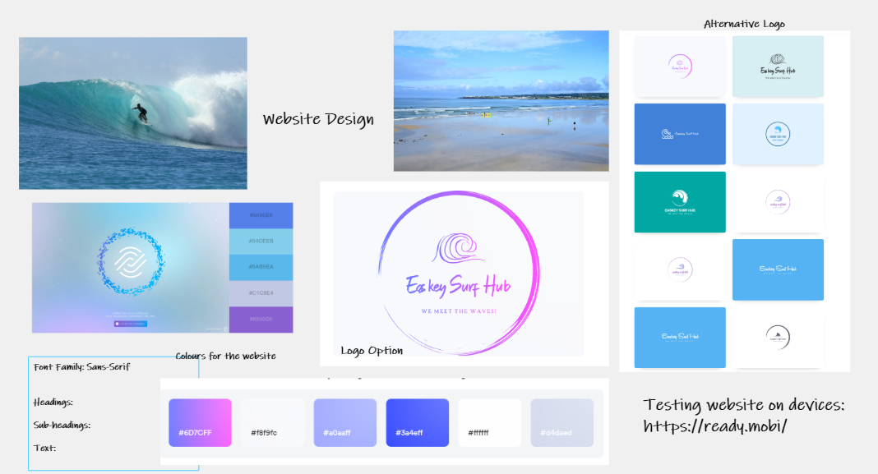
Website Planning
Our Client, Hank Flavin is a former USA junior surf champion.
We wanted the website to be:
Visually appealing
Consistent look & feel
Úna Fleming
Notes:
Una talking about requirements

Slide 5
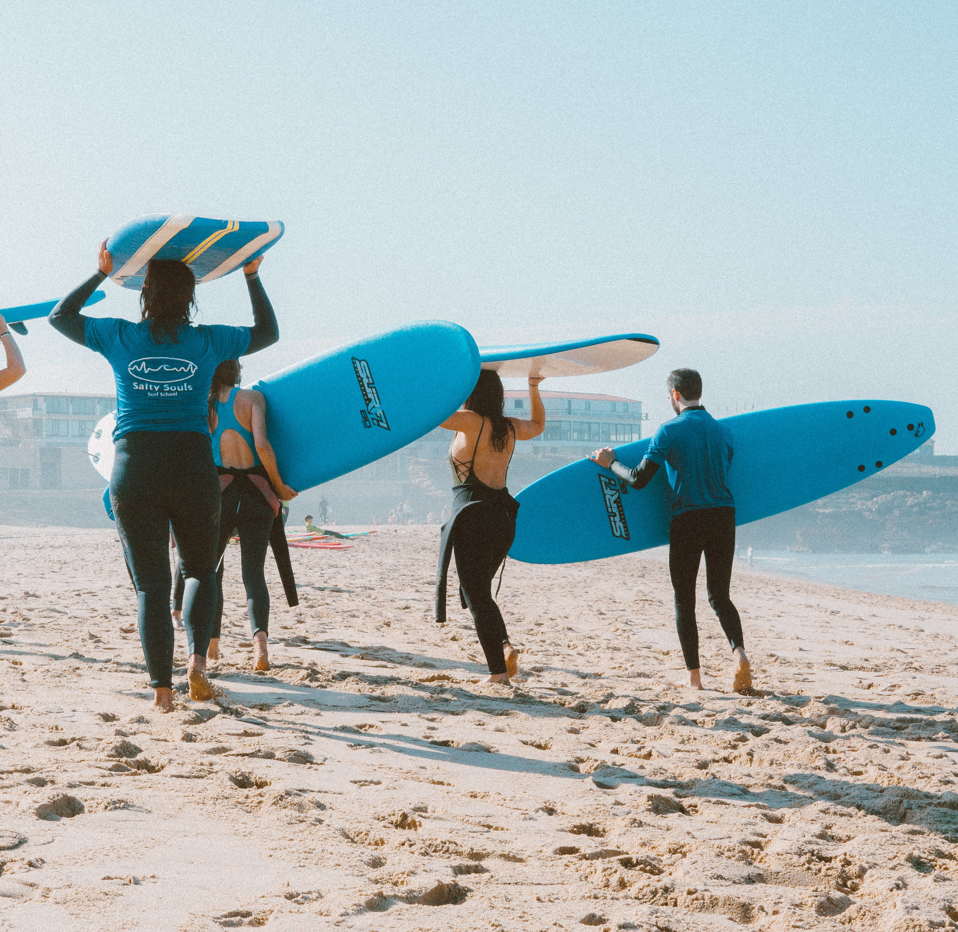
Sprint 1 Retrospective
What we learned from Sprint 1:
We each have strengths and weakness and we need to work together.
Clear communication is needed when pushing/pulling form bit bucket and before commencing tasks.
Our Team Priorities for Sprint 2:
We want to work together build on Sprint one work.
Improve functionality.
Improve testing.
Ensure consistency in quality across all webpages.
Úna Fleming​
Notes:
Una talking about Sprint 1 Retrospective

Slide 6
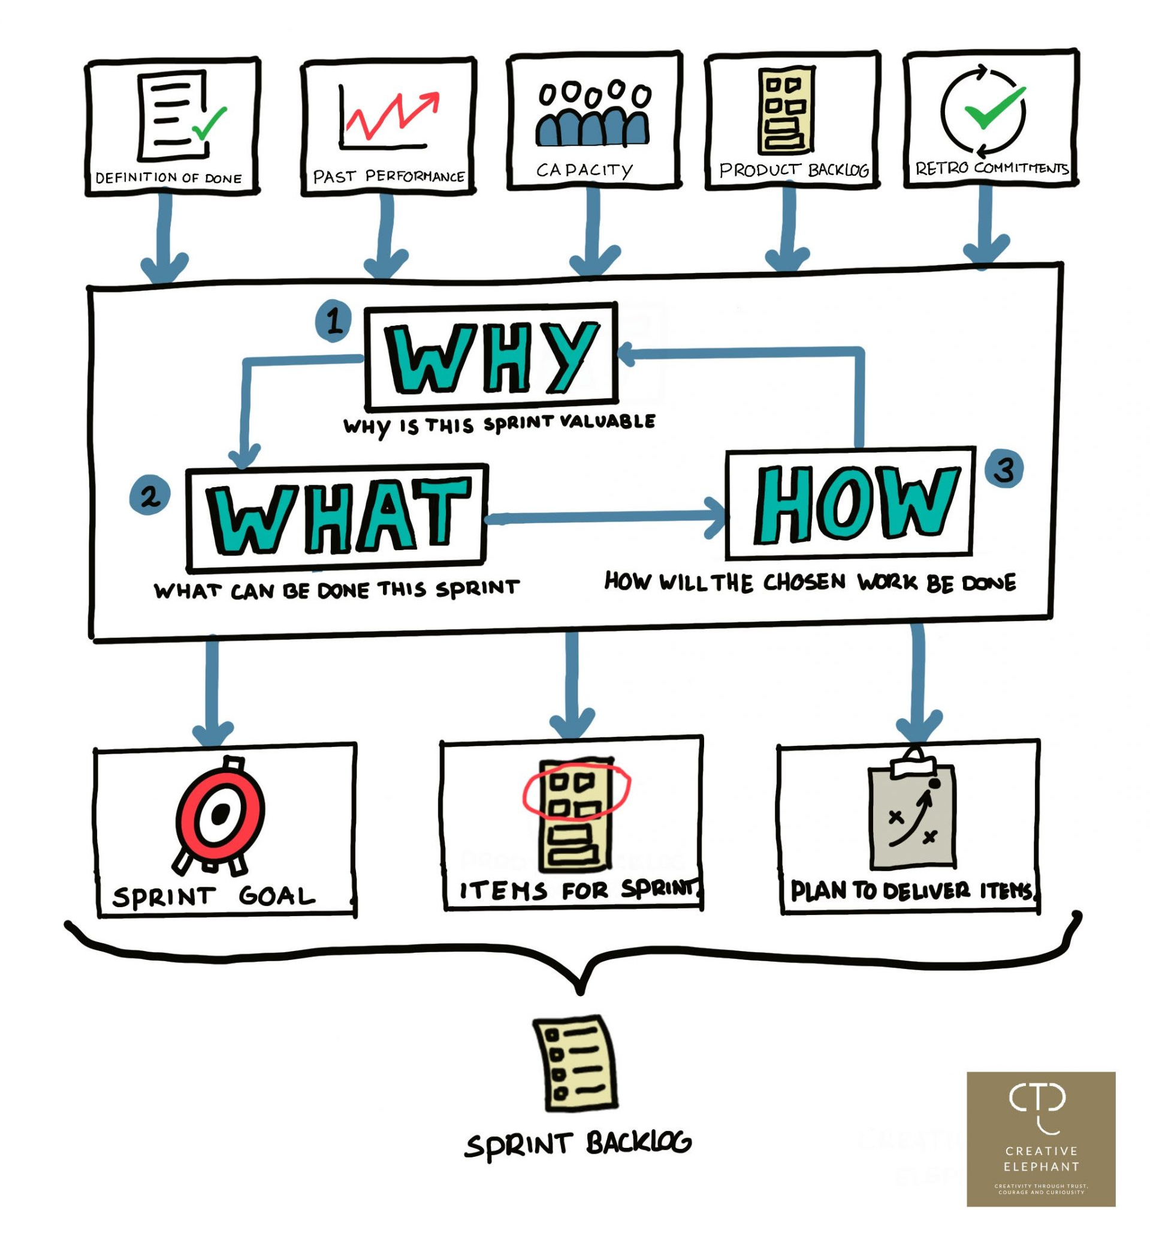
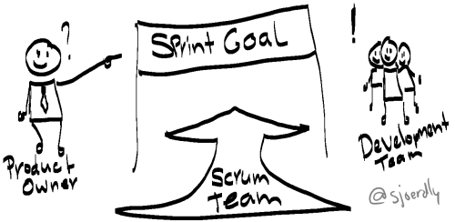
Sprint Goal
By the end of Sprint, customer should be able to book a lesson or accommodation, and staff should access to his home page.
Neslihan Onur​

Slide 7
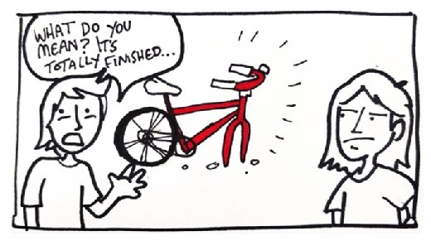
Sprint DOD
Some of the DOD criteria that we have in our User Stories
Code has been peer-reviewed by Developer
Documents updated (including images added to User Guide)
Logout button is visible on the welcome page
Images and logo should be visible
Code has passed Unit Testing
Code has passed Manual Tests
Neslihan Onur​

Slide 8



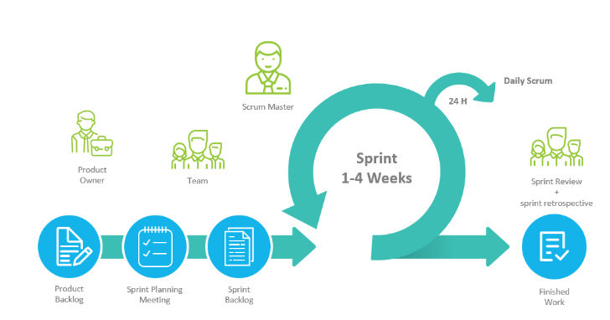




Team 5 – Agile Development Team
Daily Stand-ups with all Team members
Scrum Master
Timeboxing events
Priorities tasks
Focus on working features
Collaboration
Review
Push & Pull
Code
Branch
Merge
Yuzhou Shao​ (Ken)

Slide 9














Project Architecture and Technologies
GUI Layer
Client Side
request
Browser (HTTP)
JSF Pages
JSF Beans
response
Application Server
Project
Managed
by
Developed on
Source Controlled
by
Build by
Neslihan Onur​

Slide 10
Benefits of online surfing website to the customers
Color Codes
Features
Start
Daily Package?
Yes
Accommodation Booking Page
Conditional Operations
Display
Browse Packages
No
PayPal Online Payment
Benefits
Online visibility
Online Registration
Online booking
Surfing lessons
Accomodation
PayPal Payment
Book a Lesson
Payment Confirmed By PayPal?
Registered?
No
Registration
No
Yes
Yes
Logged In?
No
Surf Lesson Booking (+ Accommodation) Confirmation
Yes
End
Neslihan Onur​​
Notes:
Customer will able to browse packages available on the website.
Once a customer is registered in the system the customer will have the facility to directly book surf lessons over the Internet.
For the daily package, the customer will be prompted to book accommodation.
The customer will pay for the packages using the Paypal online payment.

Slide 11
Sprint 1
Total User stories:5
Total Story Points Allocated:35
Total User stories:15
Total Story Points Allocated:124
Sprint 2
Gayathri Sangavi

Slide 12
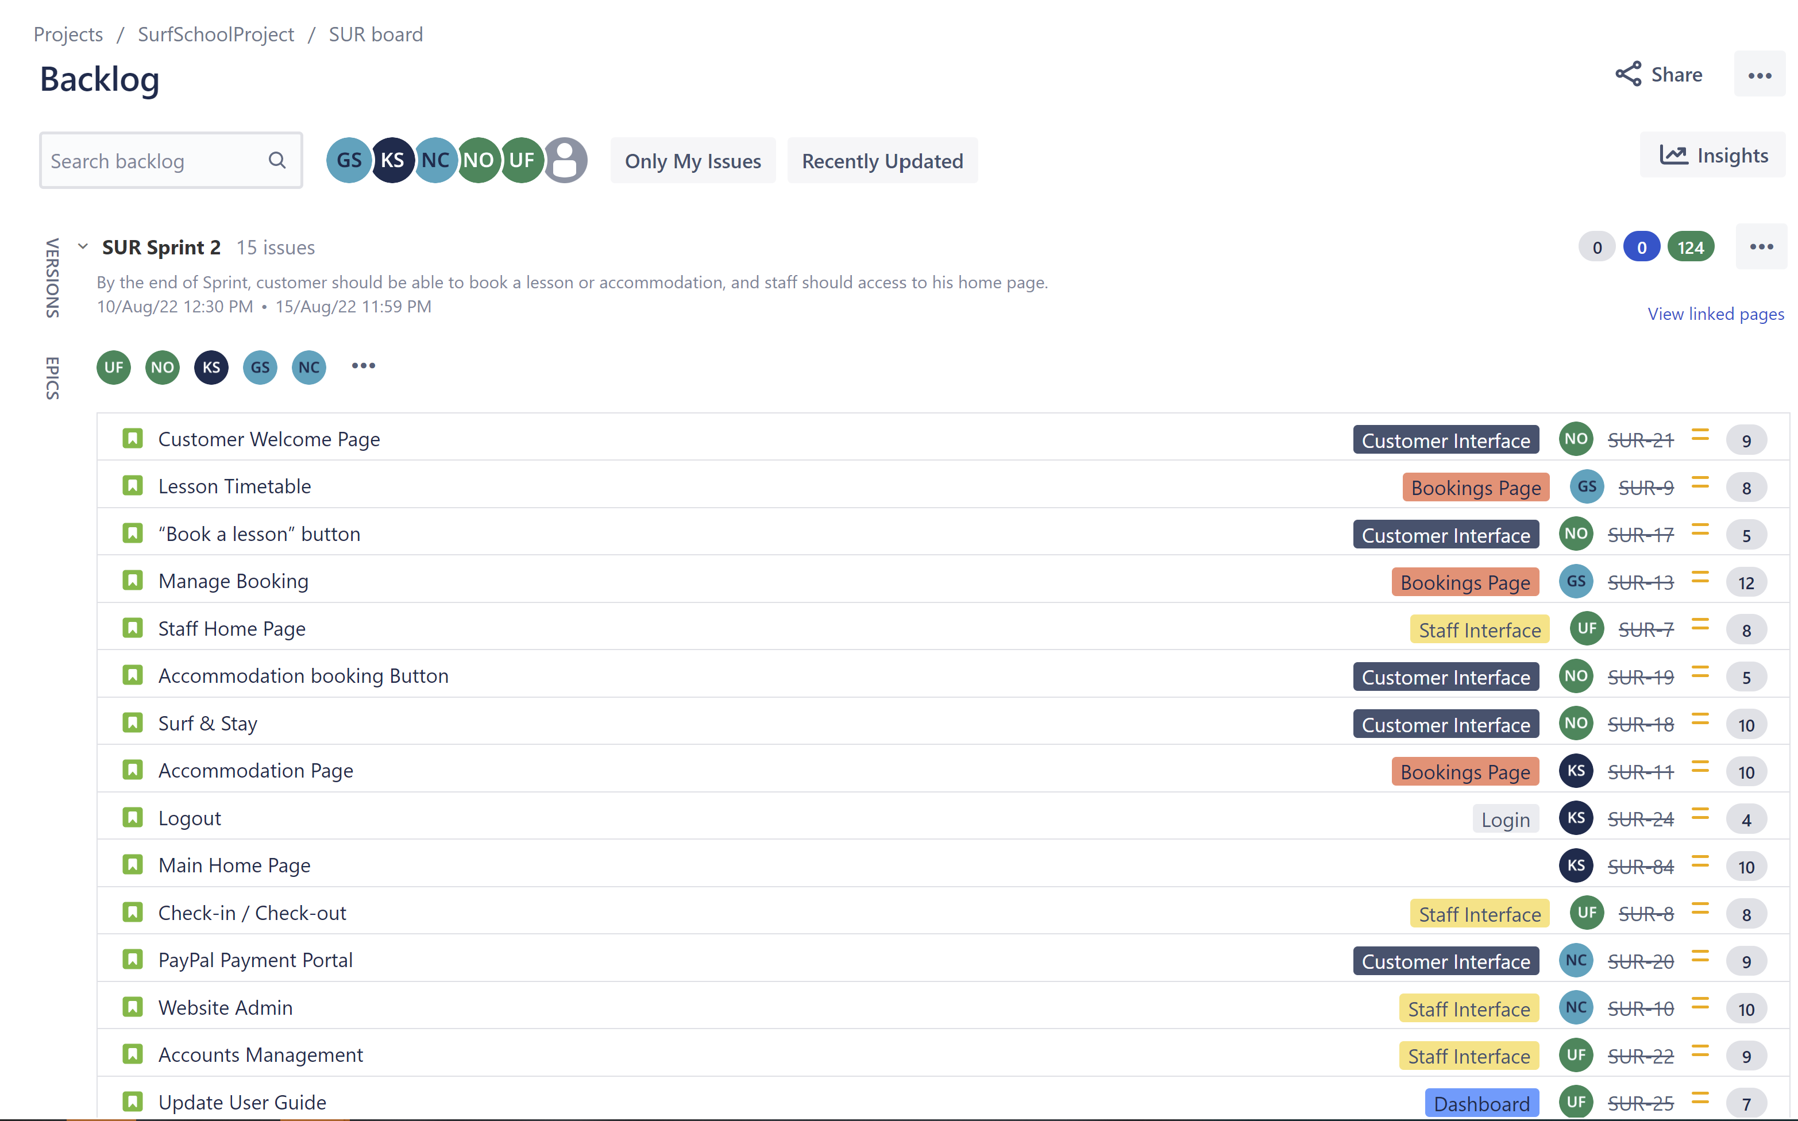
Sprint Backlog
Gayathri Sangavi

Slide 13
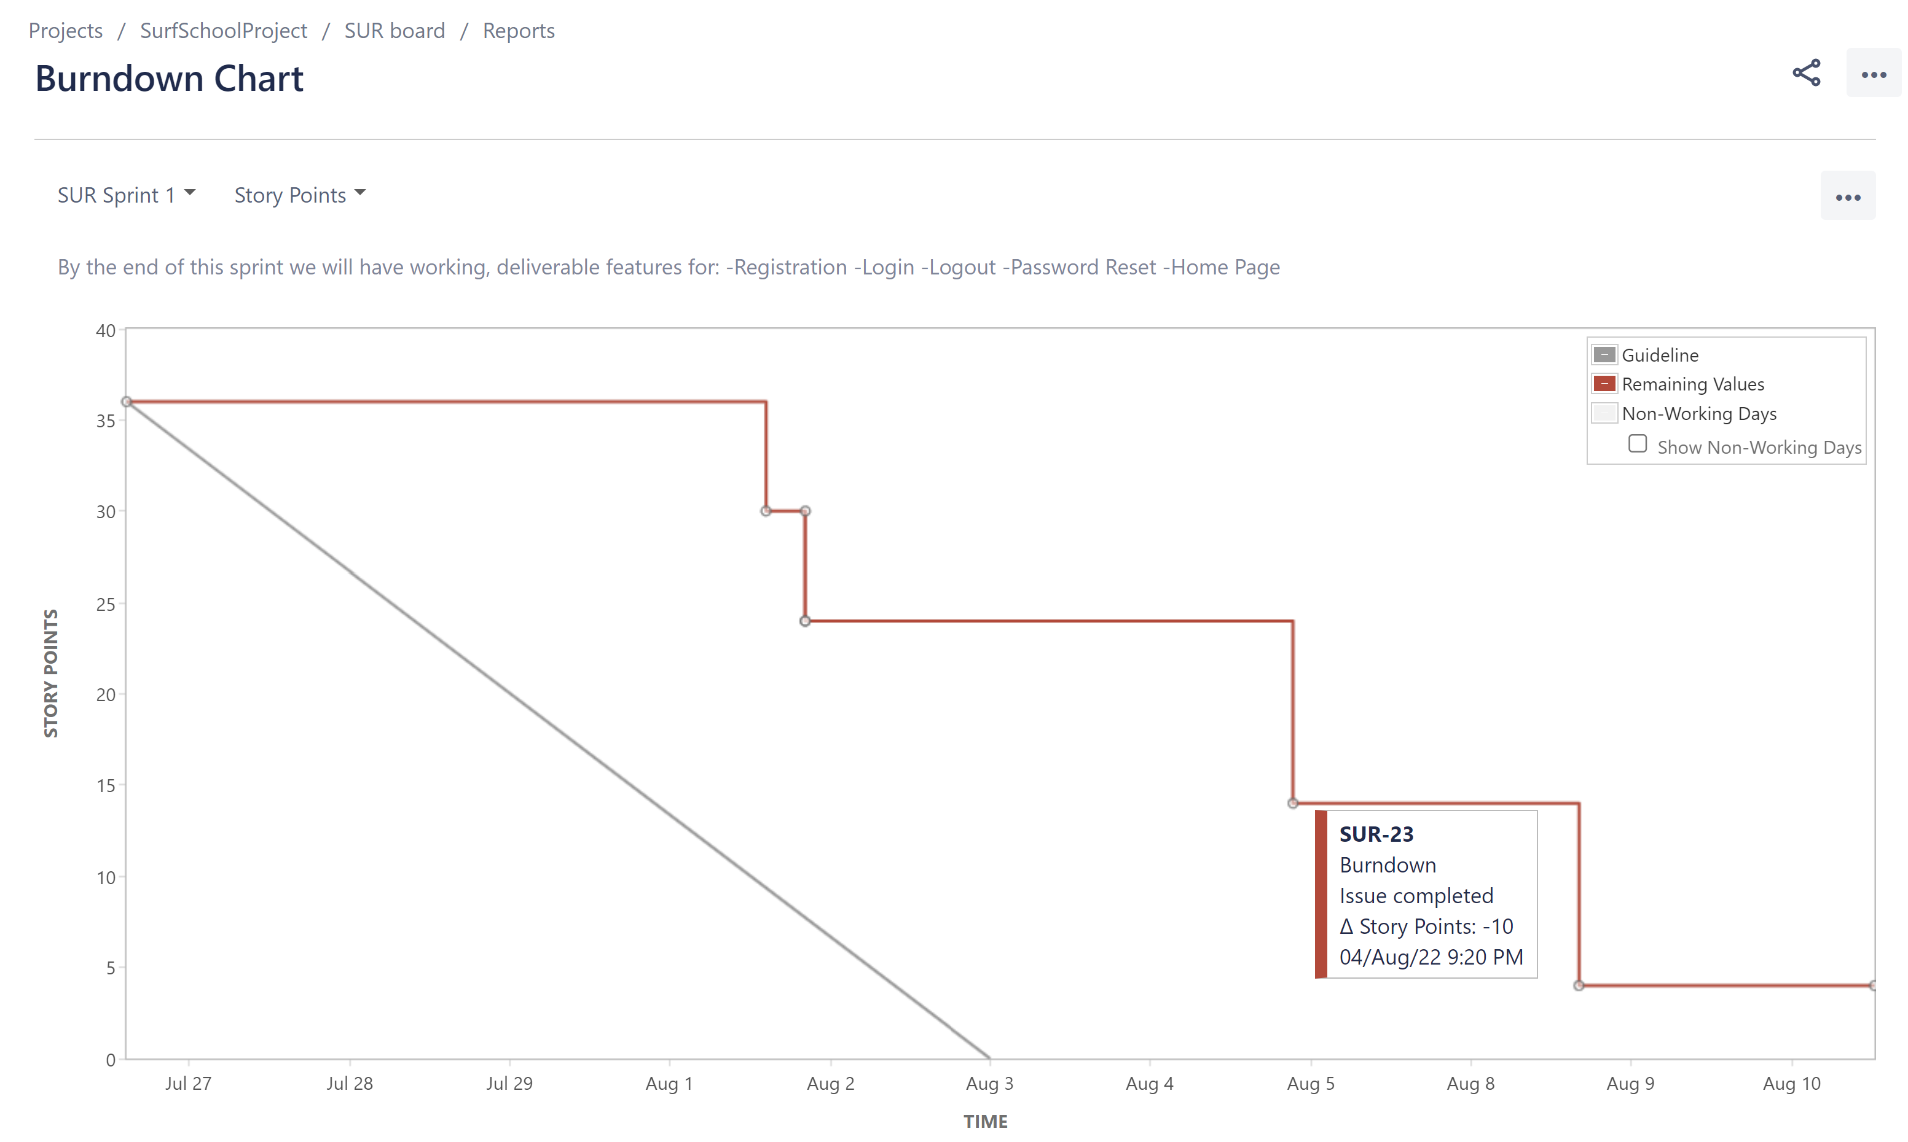
Sprint 1 Burndown Chart
Gayathri Sangavi

Slide 14
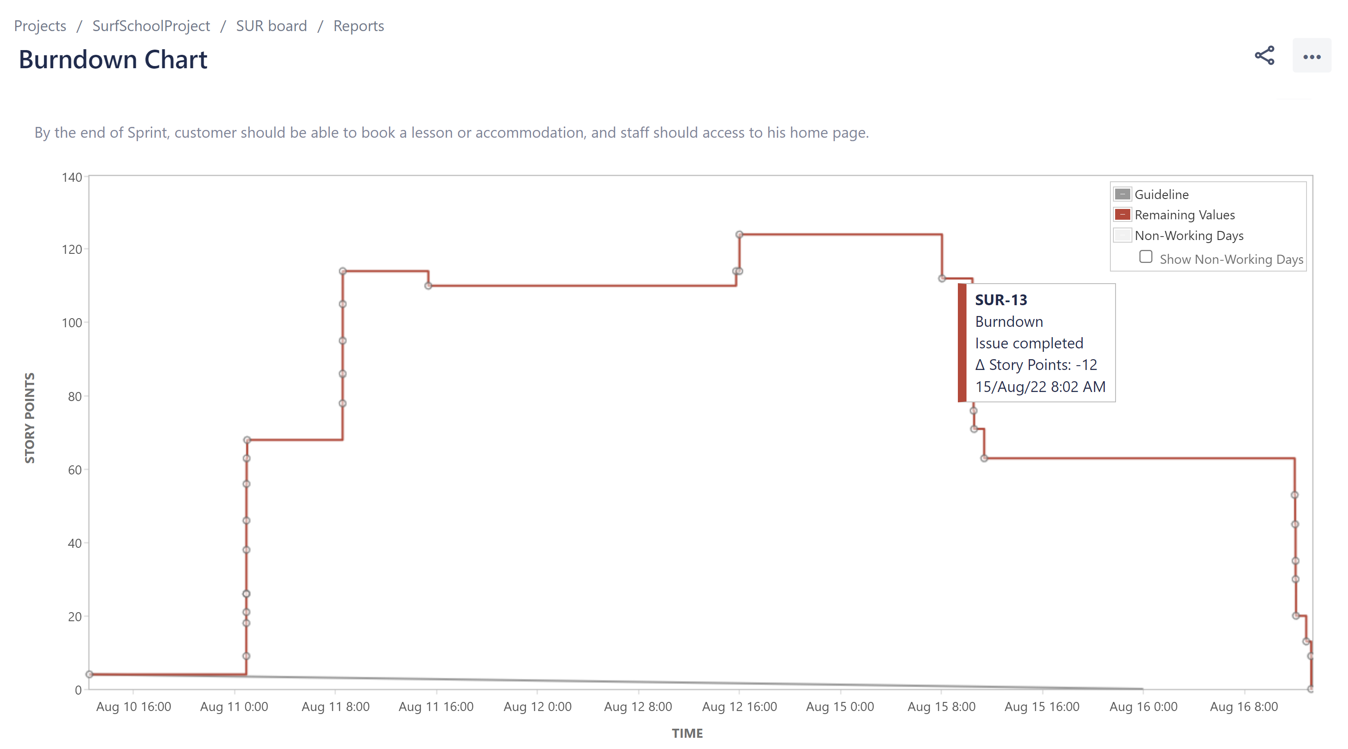
Sprint 2 Burndown Chart
Gayathri Sangavi

Slide 15
Testing Our Website
Requirements Understanding
Unique to project
Expectations agreed
Allocate time
Assign tasks
Test Creation
Collaborate
Write JUnit Tests
Test Reporting & Sharing
Clear pathway
Share Test code
Check coverage
Ensure results are shared with team
Test Planning
Planned setup
Feedback
Review
Revise if needed
Gayathri Sangavi

Slide 16
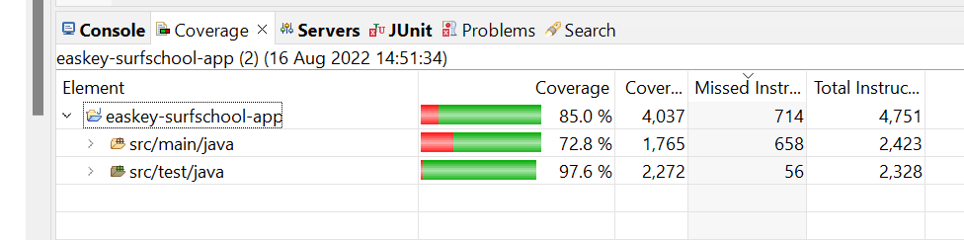
Coverage Report
Gayathri Sangavi

Slide 17

User Guide
Requirements for our user guide:
Text must be easy to read.
Images of all pages need to be included.
User guide must have logical flow and reflect user flow through the websites.
Guide must be kept up to date!
Úna Fleming​
Notes:
Una talking through our user guide

Slide 18

Demo
This project required the development of a website with the following:
> Landing page for unregistered Users to learn about Easkey Surf School
> Secure & Tested User Login System
> Online Payment Options (Paypal)
> Booking functionality (separate requirements for Staff/ Customers)
Nat Cafolla

Slide 19
Thank you!
We have greatly enjoyed working together on this project and I have learnt many skills while completing the Easkey Surf School Website!
Nat Cafolla

